Slide 1
Student Youth Institute 2016
Marquette University Law School and Eastern District of WI Bar Association

Slide 2
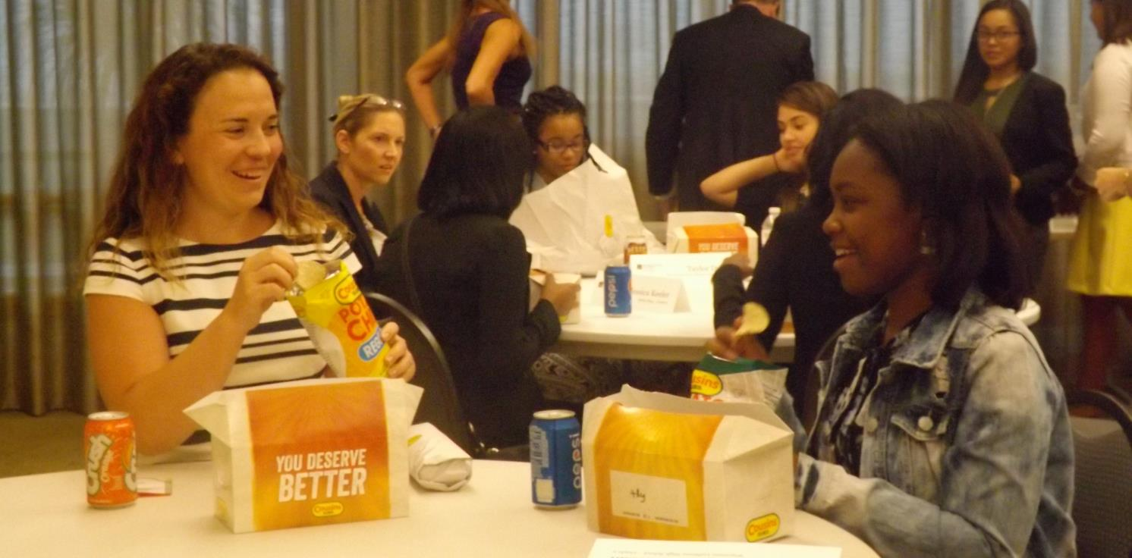
Day 1: Introductions

Slide 3
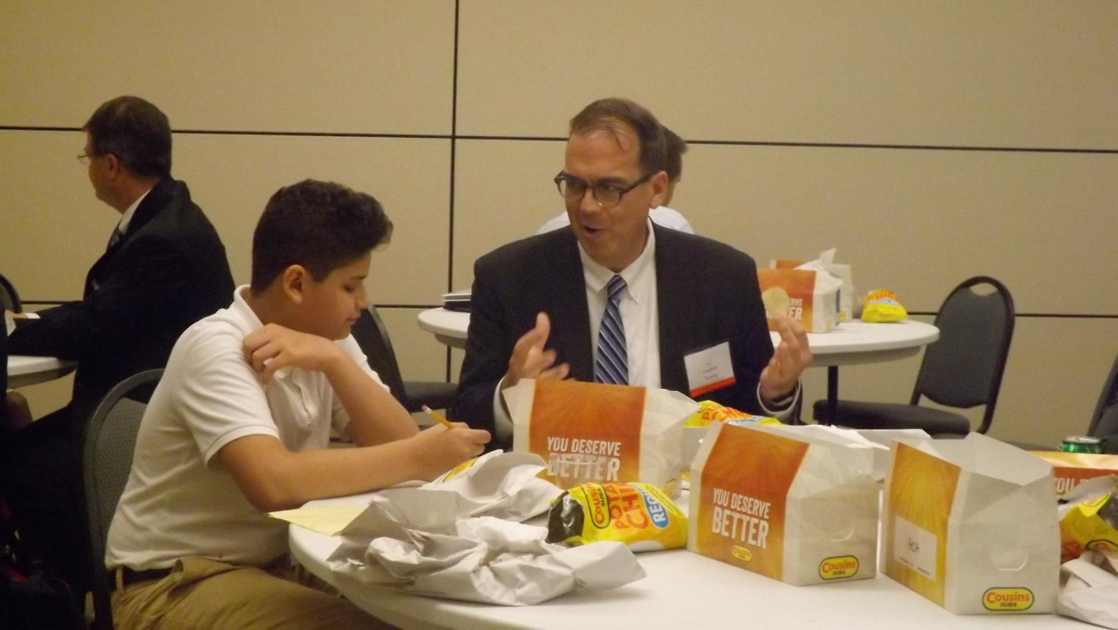

Slide 4
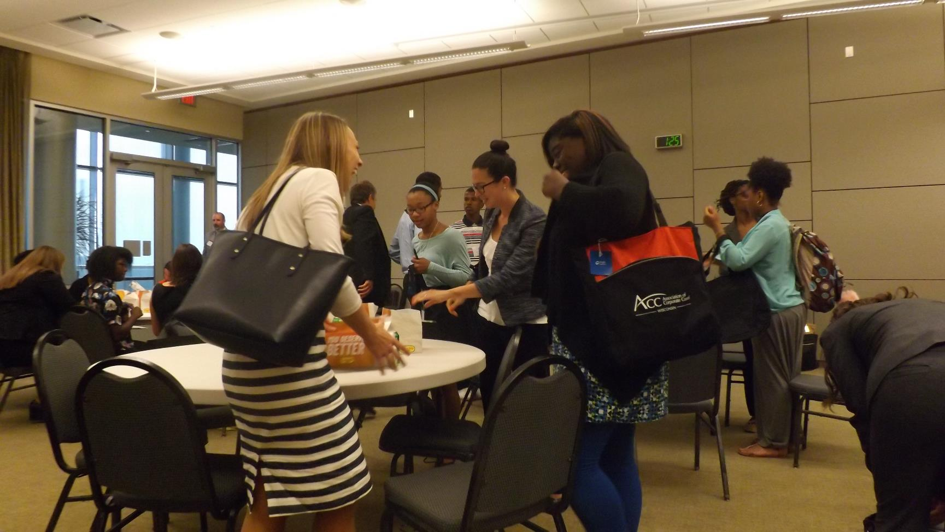

Slide 5
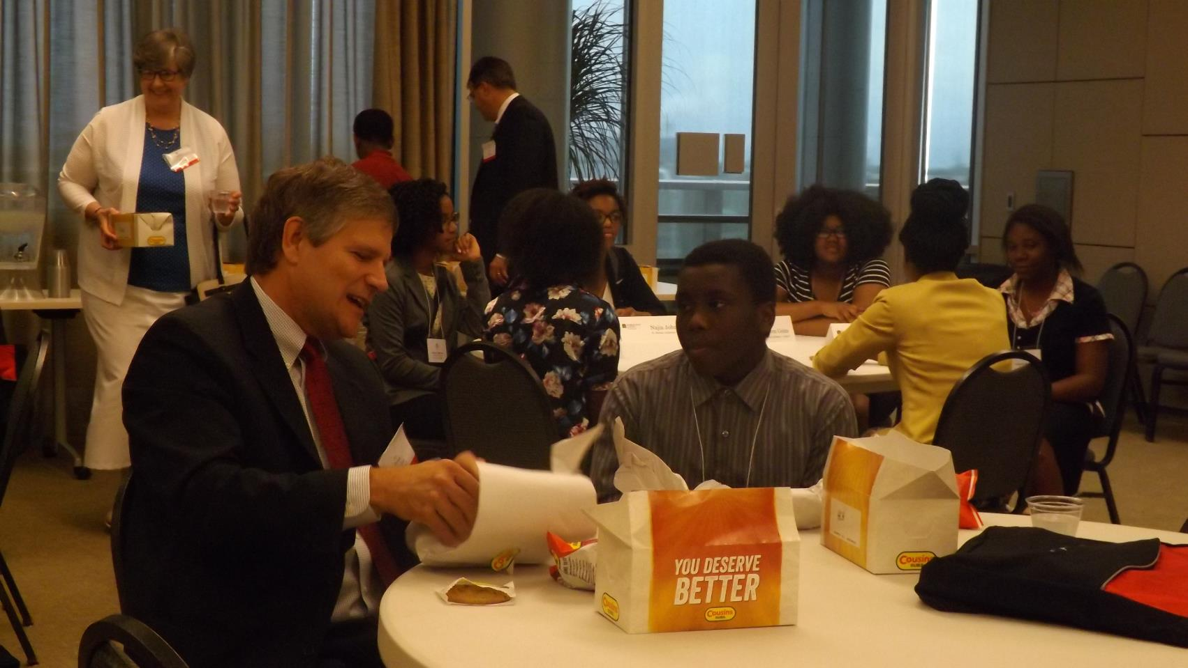

Slide 7
Welcome from Dean Kearney

Slide 8
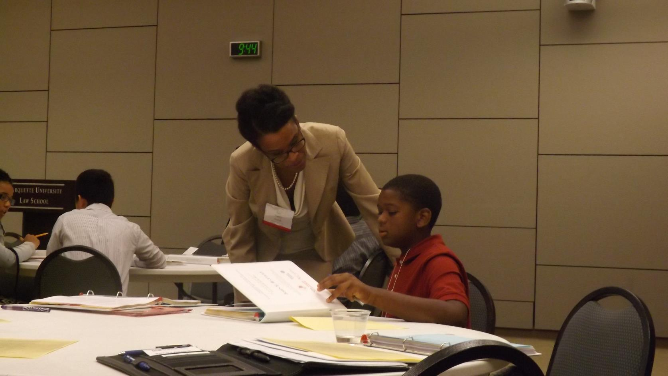

Slide 9
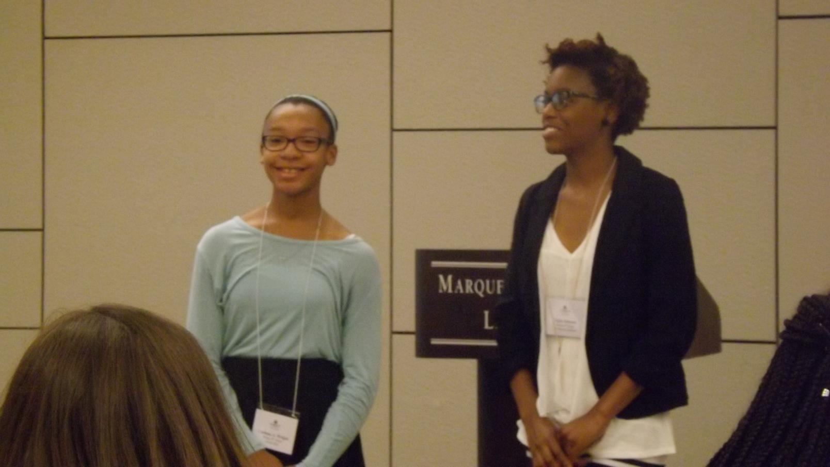

Slide 15
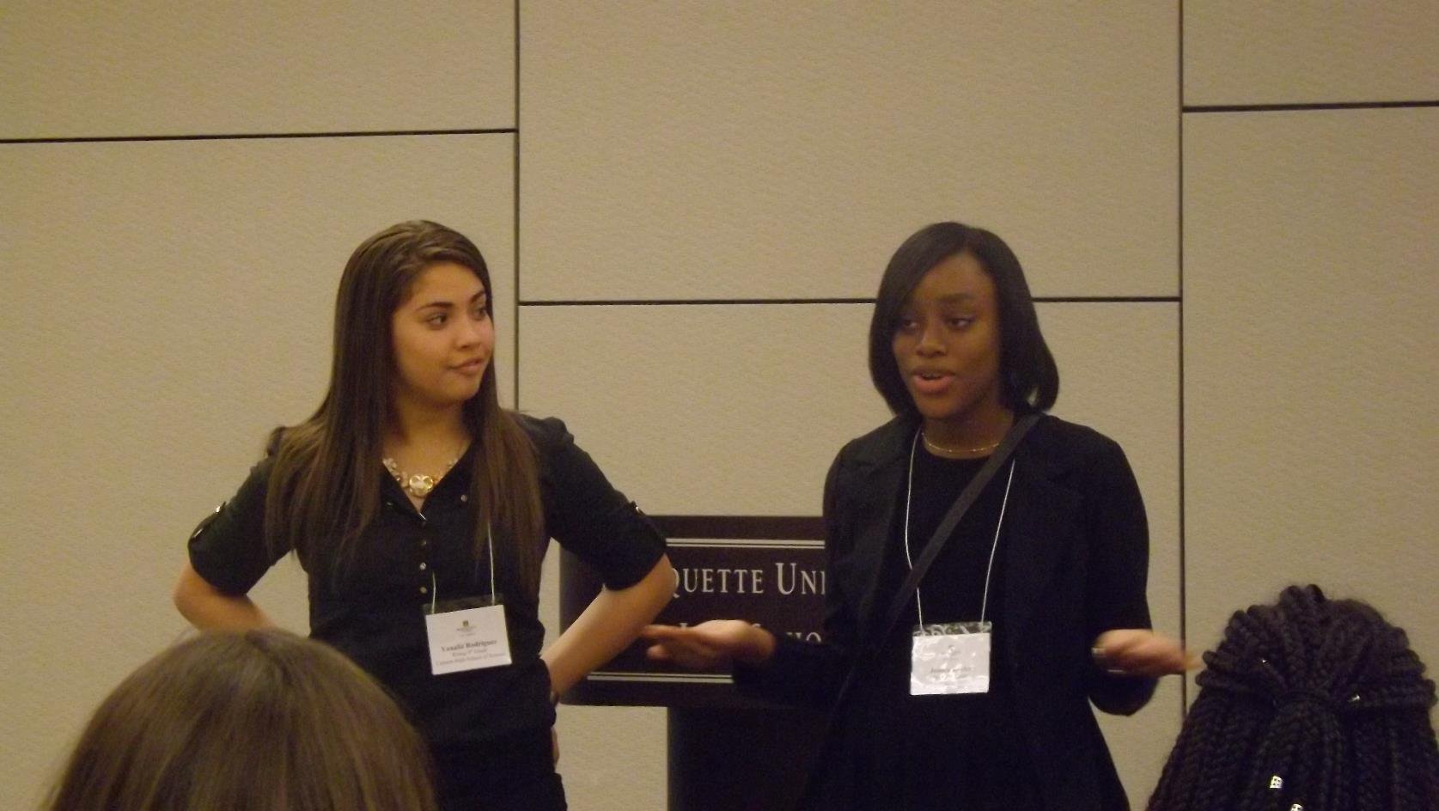

Slide 16
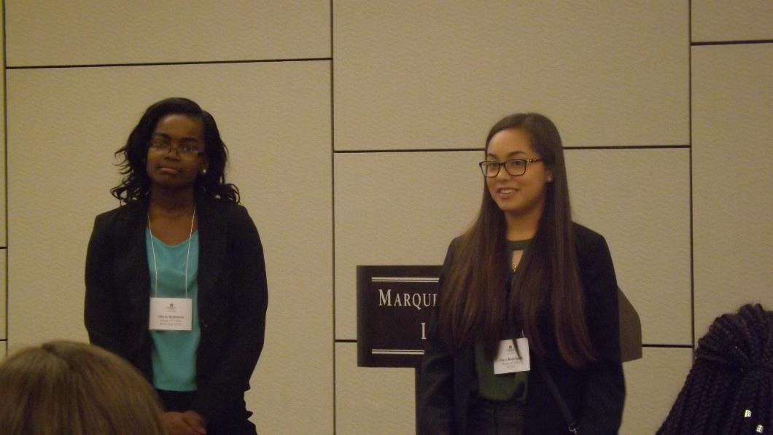
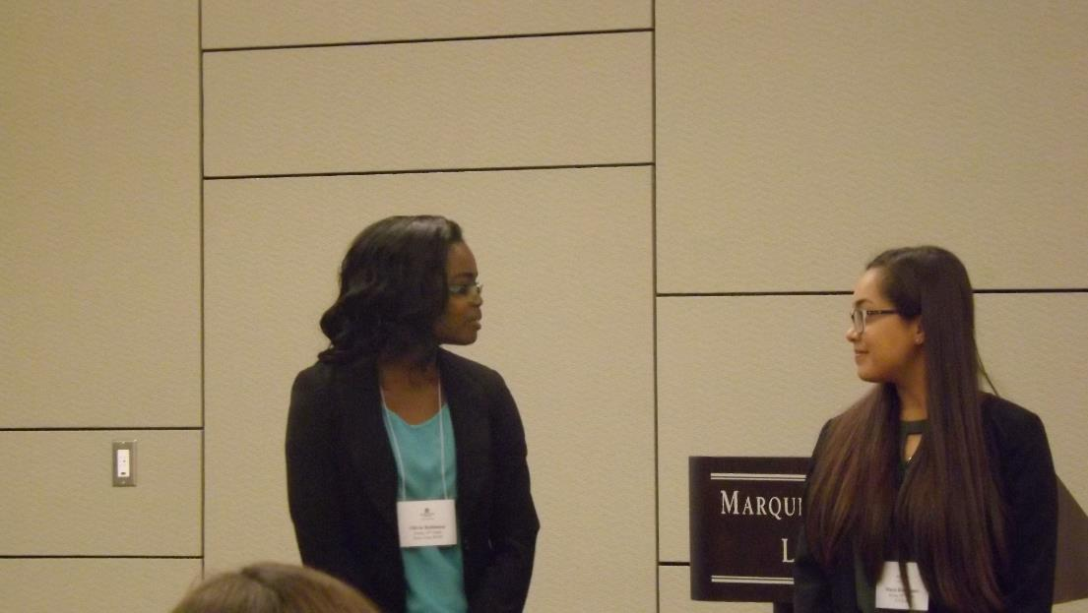

Slide 17
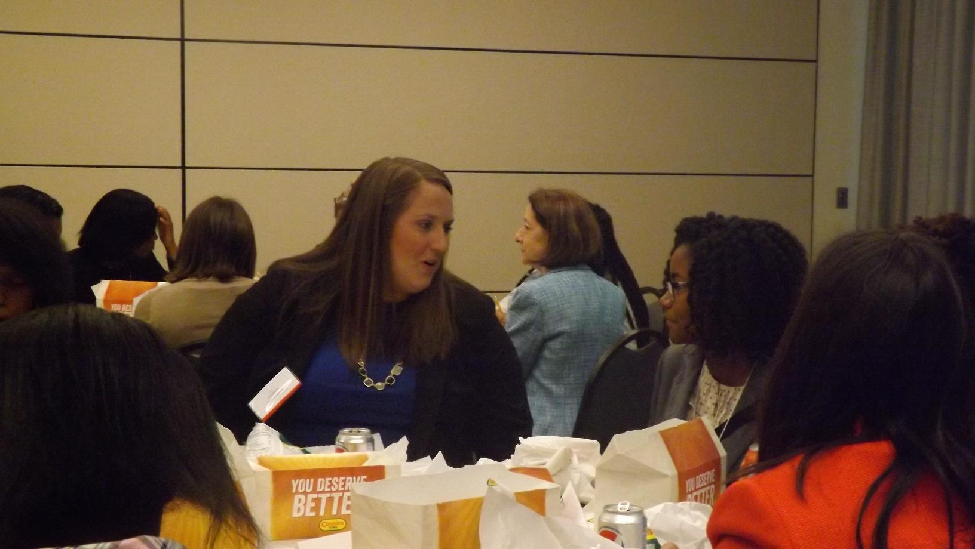

Slide 22
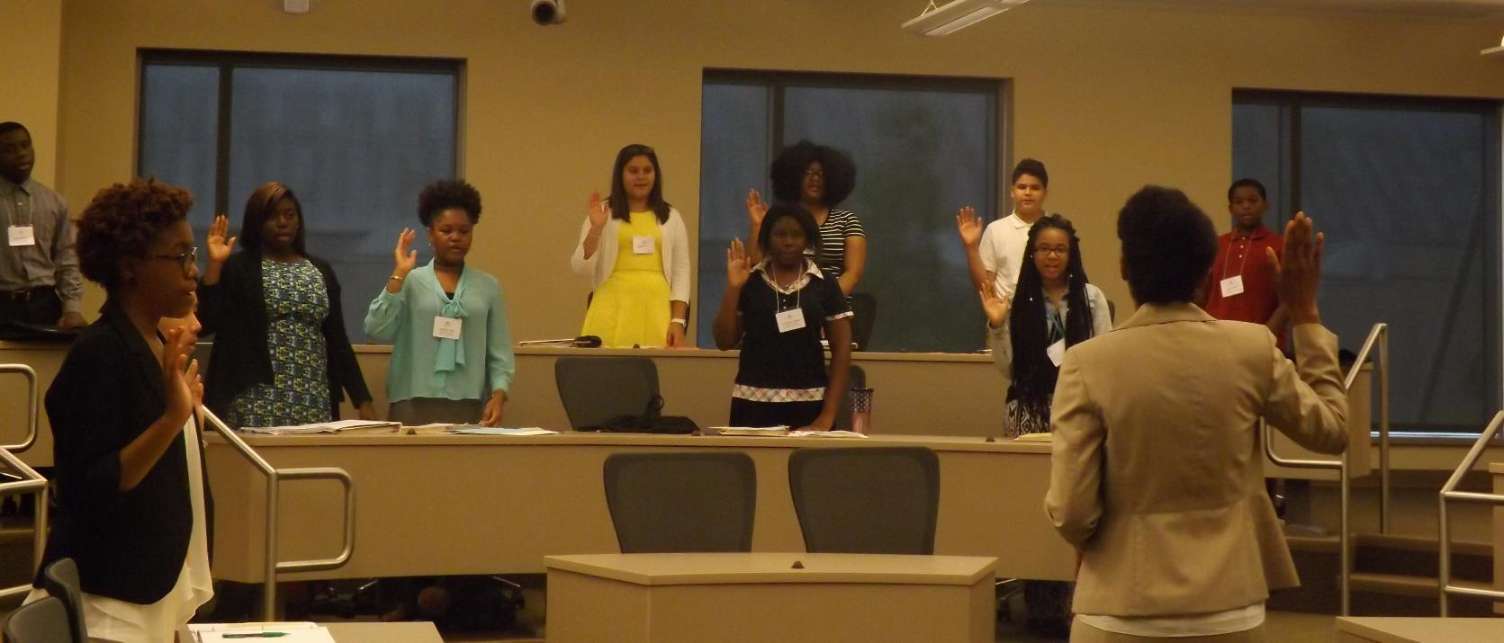
Taking Oath with Judge Joseph

Slide 24
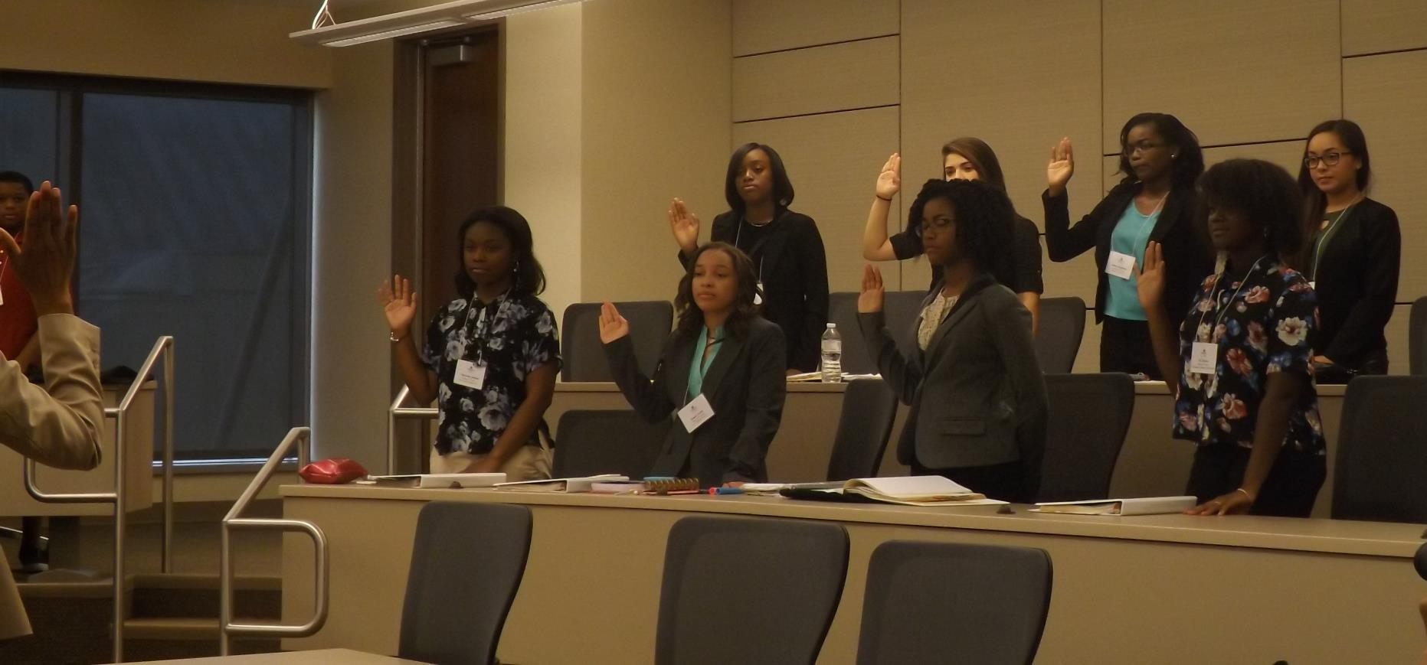

Slide 27
Day 2: Judge Carl Ashley

Slide 38
Day 3: Robert W. Baird and Foley & Lardner

Slide 39
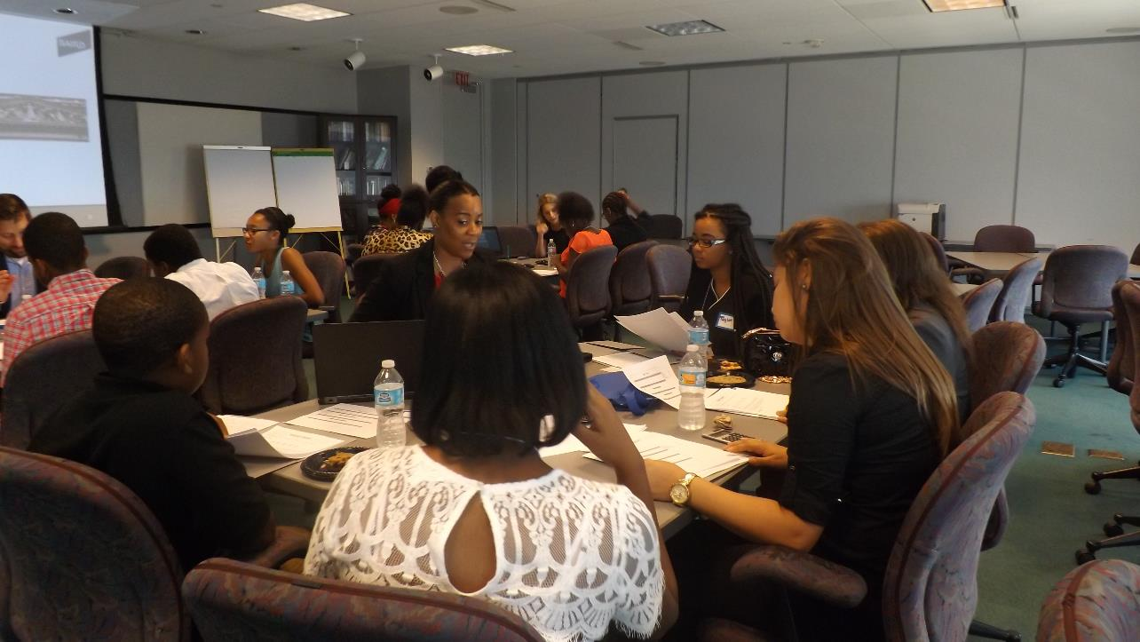
Robert W. Baird

Slide 49
Foley & Lardner

Slide 52
Day 4: Harley Davidson Museum

Slide 61
Oral Argument Prep

Slide 73
Other Careers in Law

Slide 83
Day 5: Federal Courthouse

Slide 115
Day 6: Milwaukee County Courthouse

Slide 122
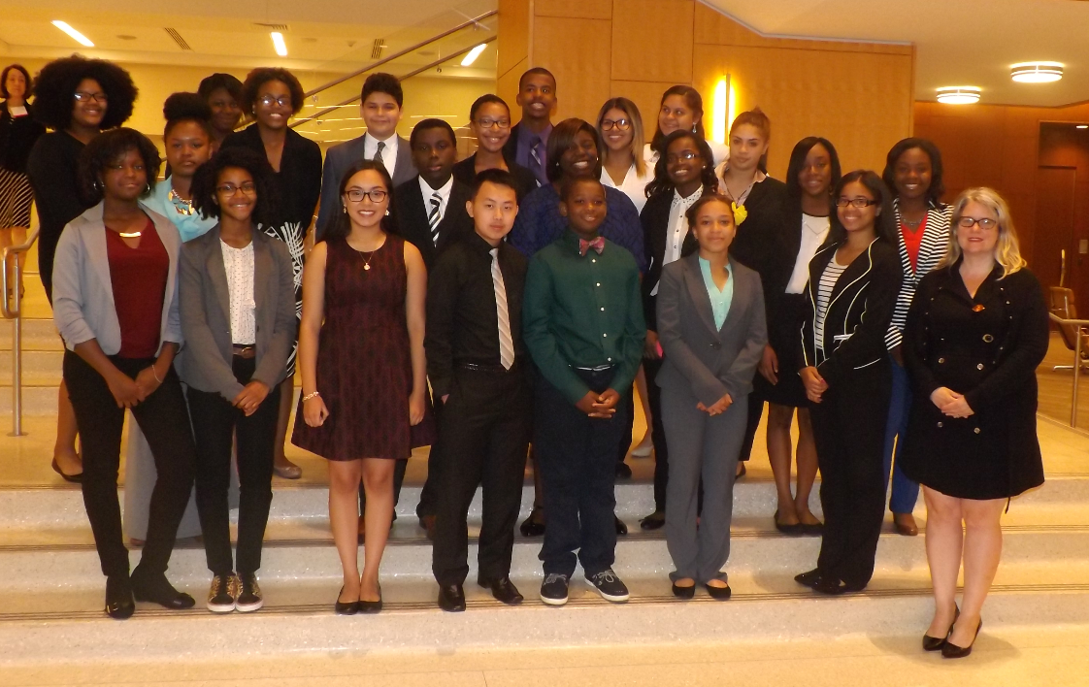
Day 7: Oral Arguments and Celebration

